Slide 1
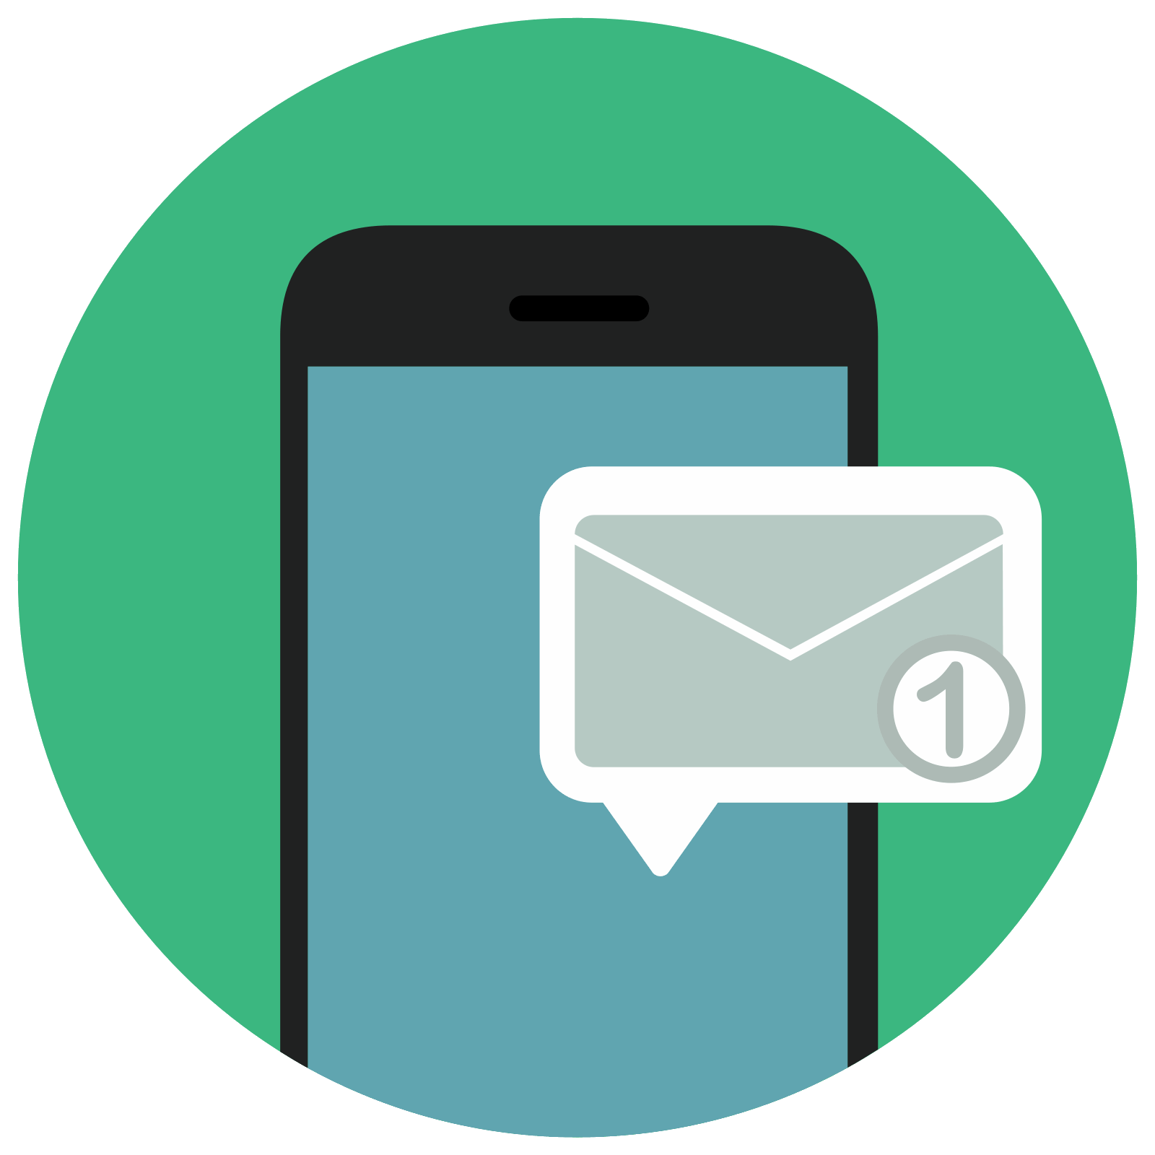
Unlocking the power of notification apps: A comprehensive introduction
Introduction to notification apps
NOTIFYME

Slide 2
what is notification app
A notification app is a software application that sends alerts to users about important events, updates, or information.
These alerts can be delivered in various forms, including push notifications, text messages, emails, or in-app notifications.
Notification apps are used by a wide range of businesses and organizations, including social media platforms, news outlets, e-commerce sites, and more.
They can be designed to provide real-time updates on a variety of topics, such as news, sports, weather, and traffic, or to notify users of specific events, promotions, or deals.

Slide 3
How thIS Notification App Works:
The notification app continuously monitors various sources, such as government websites, job portals, or company websites, to detect new circulars.
When a new circular is published, the app receives the data and processes it to create an alert.
The alert is customized based on the user's preferences, such as the type of circular, the location, and the application deadline.
The app sends the alert to the user's device through various channels, such as push notifications, text messages, or emails.
The user can view the details of the circular by clicking on the alert, which will open a webpage or a section within the app that contains the full information about the circular.
If the user is interested in the circular, they can apply for it directly from the app by following the application process provided in the circular.

Slide 4
THOSE PROBLEM SOLVES NOTIFYME :
Job circulars are published in various sources, such as government websites, job portals, or company websites, making it difficult for people to find the ones they are interested in.
Many circulars are not easily accessible or require users to have specific skills or knowledge to find them.
People who live in rural areas or have limited access to the internet may not be aware of the circulars that are available or may not know how to access them.
Even people who are familiar with the process of finding job circulars may have to spend a significant amount of time searching through various sources to find the circulars they are interested in.
This process can be frustrating and time-consuming, and may result in people missing out on job opportunities.

Slide 5
Facilities and Impact of a Notification App:
A job circular notification app can provide users with a one-stop solution for finding job circulars from various sources.
By receiving timely and relevant alerts about new job circulars, users can stay informed about job opportunities without having to spend a significant amount of time searching for them.
The app can customize the alerts based on the user's preferences, such as the type of job, the location, and the application deadline, making it easier for users to find the circulars they are interested in.
The app can also provide additional features, such as a resume builder, interview tips, and career advice, to help users prepare for the job application process.
By making it easier for people to find job circulars and apply for jobs, a job circular notification app can have a positive impact on employment rates and help reduce the time it takes for people to find jobs.

Slide 6
THOSE PEOPLE CAN TAKE THE SERVICE TO EASY THEIR LIFE:
JOB SEEKER
STUDENTS SEEKING ADMISSION AND SCHOLARSHIP
TEACHERS
THE PEOPLE WHO WANTS SPECIFIC ALERT FROM VARIOUS WEBSITES.

Slide 7
THIS IDEA IS GENARETED BY
MD REZWAN HASAN TAMIM
UNIVERSITY OF BARISHAL

